Slide 1
FinSight AI Assistant AI-Powered Enterprise Finance Analytics Copilot
Presented By: Mahima Bhatt

Slide 2

About Me
Mahima Bhatt
Texas A&M University
India
Corp DT ERP Platforms
Mr. Kiran Goppisetti

Slide 3

Agenda
Week overview
Problem statement
Process summary
Solution Breakdown
Conclusion
Key takeaways

Slide 4
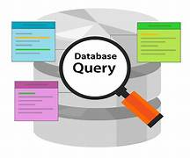
Problem Statement
Work Order and Supplier data remains buried in manual SQL — limiting finance agility

Slide 5
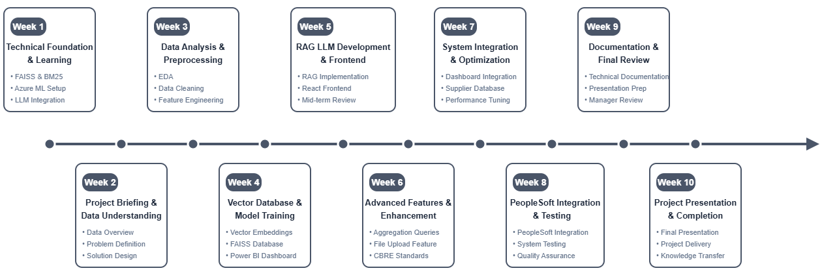
Timeline

Slide 6
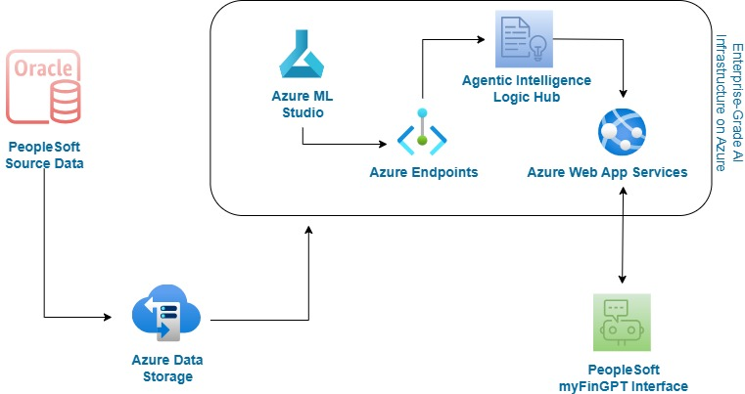
Architecture Overview

Slide 7
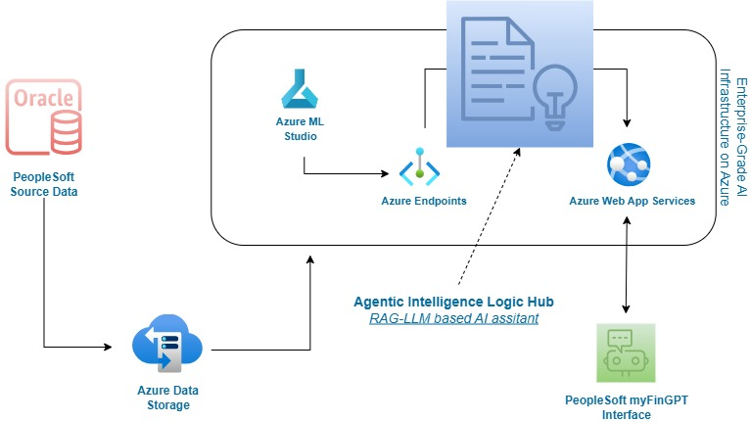
Architecture Overview

Slide 8
Possible LLM Solutions for Finance Automation
1. Traditional NLP LLM -> Trained on generic internet data, lacks domain awareness, and needs complex prompts.
2. OpenAI API-based LLM -> Powerful but external, requires context every time, and raises data privacy concerns.
3. Custom Pretrained LLM Bot (Chosen) -> Trained on company’s internal finance data, domain-aware, secure, and context-free.
Domain-Specific: Understands company’s PeopleSoft, supplier, and work order data
Fully Secure: Built for internal use, aligns with company’s data policies
No Prompting Needed: Knows what you mean — no context injection required

Slide 9
5. Query Handling and LLM Reasoning
3. Vector DB & Embedding Generation
1. Data Preprocessing
Exploratory Data Analysis​​
Data Cleansing​​
Data Transformation​​
Synonym Matching​​
Hybrid Retrieval (lookup,aggregation)
File Summarization or Explanation
Vector Database generation
FAISS Index Construction
BM25 Token-Based Indexing
Dual Retrieval Alignment
Process Overview
4. Query Intent Classification
6. Frontend UX and Output Formatting
2. Retrieval Strategy Experimentation
Intent Detection (lookup, aggregation, explanation)
Dataset Selector (work order, supplier data)
FAISS only
BM25 Only
Hybrid (FAISS + BM25)
TF-IDF
Elastic Search & Qdrant
Chat Interface
File Upload
Natural Sentence Rendering

Slide 10
Process Overview
3. Vector DB & Embedding Generation
5. Query Handling and LLM Reasoning
1. Data Preprocessing
Exploratory Data Analysis​​
Data Cleansing​​
Data Transformation​​
Synonym Matching​​
Vector Database generation
FAISS Index Construction
BM25 Token-Based Indexing
Dual Retrieval Alignment
Hybrid Retrieval (lookup,aggregation)
File Summarization or Explanation
2. Retrieval Strategy Experimentation
4. Query Intent Classification
6. Frontend UX and Output Formatting
Intent Detection (lookup, aggregation, explanation)
Dataset Selector (work order, supplier data)
FAISS only
BM25 Only
Hybrid (FAISS + BM25)
TF-IDF
Elastic Search & Qdrant
Chat Interface
File Upload
Natural Sentence Rendering

Slide 11
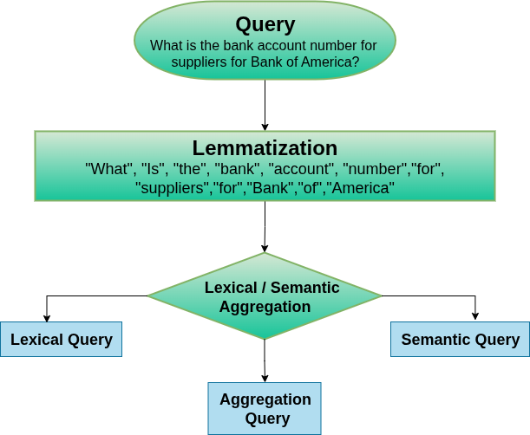
Solution Breakdown (FinSight AI Assistant)​

Slide 13
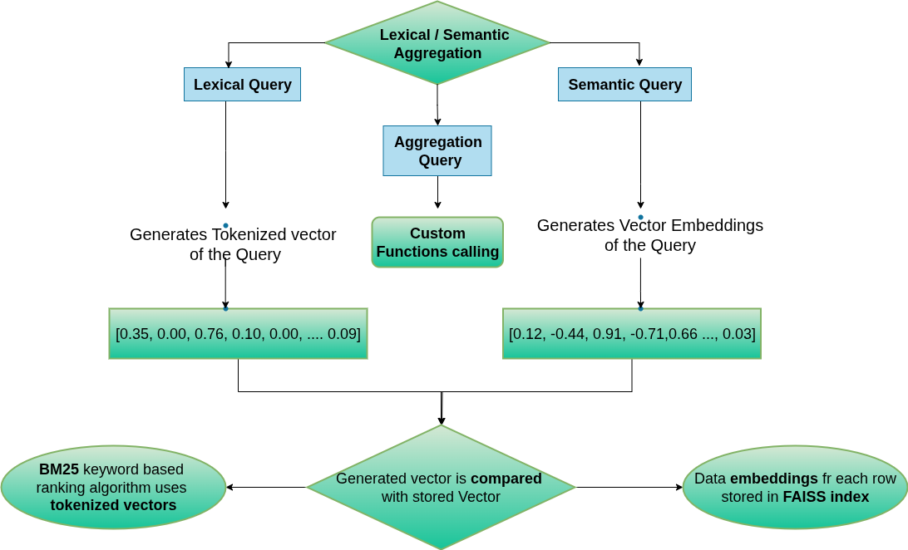
Similar word embeddings

Slide 14
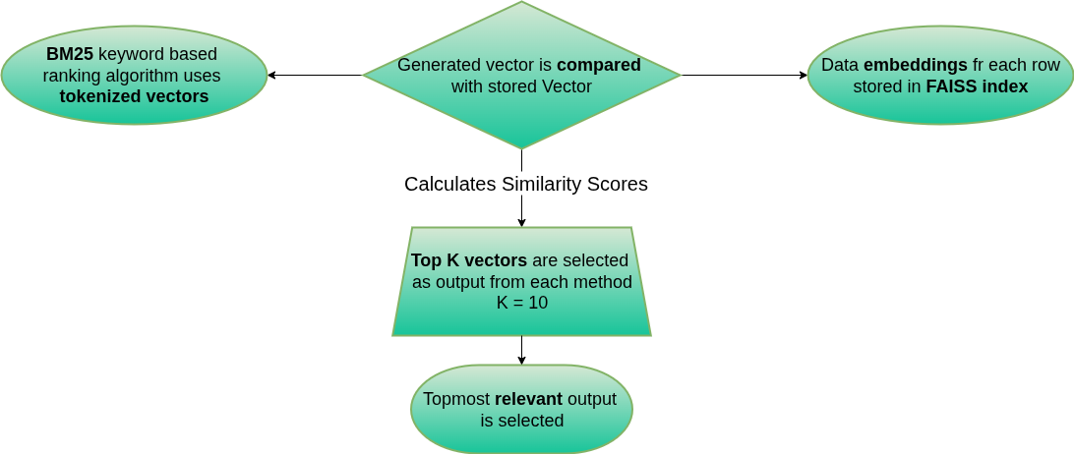
SIMILAR SENTENCE VECTOR | SCORE
1. Bank Account Number for BoA is 123xyz | 0.976
2. Bank of America has number …. | 0.811
3. BOA | 0.712
4. Bank Account Number | 0.701
5. Bank of America has Amtech as supplier 6. Bank Account Number for … | 0.691
7. Bank…. | 0.688
8. Supplier… | 0.667
9. Number…. | 0.633
10. Account… | 0.619
11. Bank Number | 0.553
. | …
. | …
. | …
N ………. | …

Slide 15
Demo

Slide 16
Conclusion
Enterprise-grade Privacy
AI-driven Capabilities
Business Impact
Built exclusively on CBRE’s internal data
Securely built LLM without exposure to external world
Aligned with finance systems with Power BI data visualization
Supports flexible natural language queries
Handles structured + vague queries
Context-aware responses
Reduced dependency on manual SQL or dashboarding
Faster decision-making
More accessible finance data

Slide 17

Key Takeaways
Agile Training D&T 101 Series Executive Speaker Series
Business
Technical Skills
Hybrid Retrieval with FAISS + BM25
Transformer-Based Embeddings
LLM-Driven Query Reasoning
Data Governance & security
File Summarization Support using LLM
Real-Time Expansion for data visualization
Women in Engineering Event D&T Intern Ping Pong Tournament Breakout Events
Volunteering at Bonton Farms
Events
Inter-Personal
Teamwork Networking Skills Time Management and Organization

Slide 18
THANKYOU!

Slide 19
Any
Questions

